Slide 1

QUANTUM
COMPUTING
FUNDAMENTALS-APPLICATIONS-USECASES

Slide 2
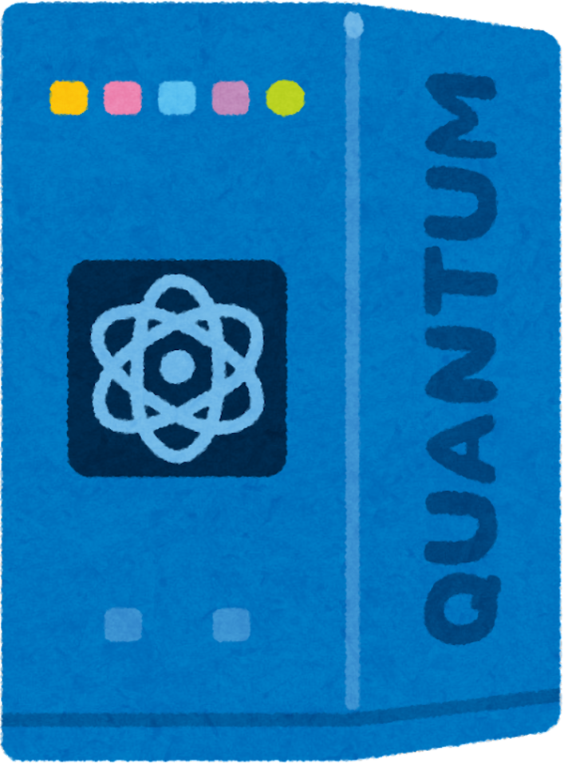
What is
Quantum Computing?
Quantum computing is a type of computing that uses quantum mechanics (the rules that govern tiny particles like atoms and electrons) to perform calculations much faster than traditional computers.
How is it different from regular
computing?
Classical Computers use bits (0s and 1s) to store and process information.
Quantum Computers use qubits (quantum bits), which can be 0, 1, or both at the same time (this is called superposition).

Slide 3
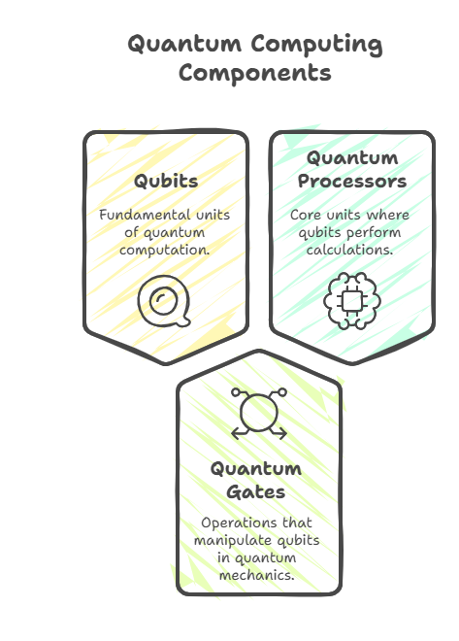

A quantum computing system is structured into three key layers, ensuring efficient operation by combining quantum and classical computing components.
Hardware Layer
Qubits (Quantum Bits): The fundamental units of quantum computation.
Quantum Gates: The basic operations that manipulate qubits, following quantum mechanics.
Quantum Processors: The core computational units where qubits interact and perform calculations.

Slide 4
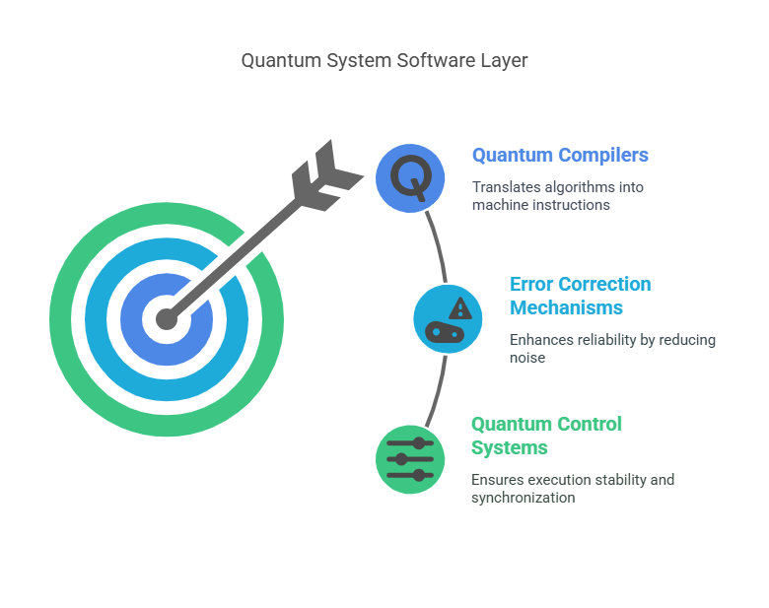
Software Layer

Slide 5
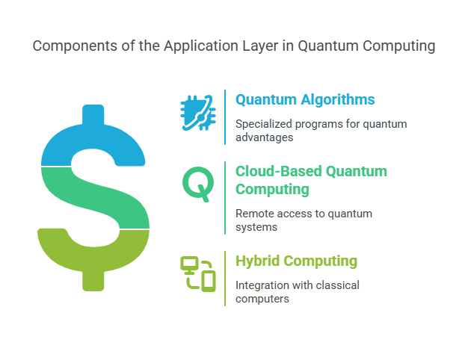
Application Layer
The application layer is where users interact with the quantum system.
Quantum Algorithms:
Specialized programs designed to solve complex problems, such as:
Shor’s Algorithm: For efficient prime factorization.
Grover’s Algorithm: For faster searching compared to classical methods.
Cloud-Based Quantum Computing:
Allows developers to run quantum programs remotely (e.g., IBM Quantum, Google Quantum AI).
Hybrid Computing:
Though Quantum Computer seem to be more reliable , but they still requires classical computers support to ensure efficiency.

Slide 6
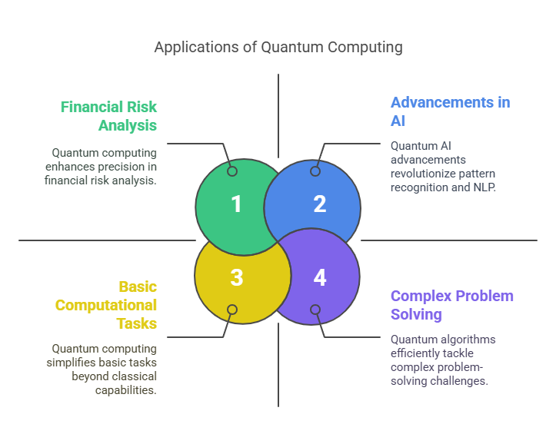
Relevance of Quantum Computing

Slide 7
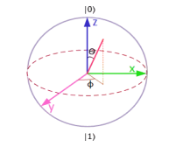


Quantum Computing’s Power and Progress(IEEE)
Potential Beyond Classical Limits
Global Trends
Superposition and Entanglement
Why Quantum Computing Matters
Historical Milestones
Qubit Representation
Key Implementations

Slide 8
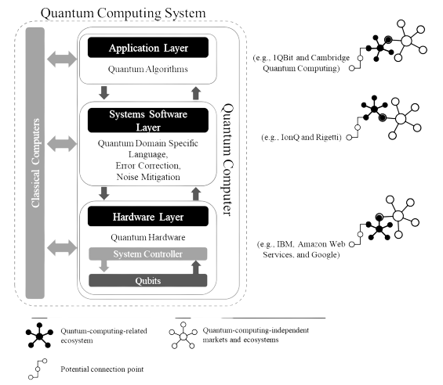

Quantum as a Specialized System and Business Frontier(Springer)
1.
Hybrid Quantum-Classical Systems
2.
Three-Layer Architecture
3.
Ecosystem Emergence
4.
Access Barriers

Slide 9

IBM’s Quantum Computing Journey (Case Study)
IBM has been a pioneer in quantum computing, contributing significantly to its theoretical and practical development.
The company transitioned from classical computing research to quantum research, leveraging superconducting qubits​
IBM's research focuses on scalable fault-tolerant quantum computers.

Slide 10
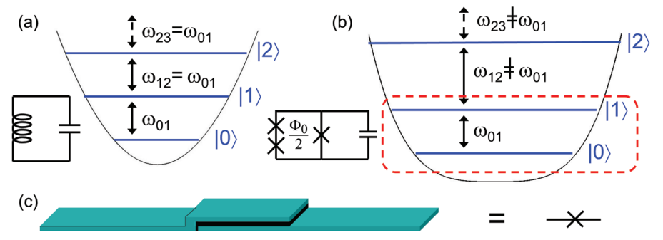
IBM’s Quantum Computing Implementation
IBM developed superconducting qubits, which provide a foundation for quantum computing​
The company focuses on error correction techniques and improved coherence times to enhance quantum performance.
IBM's cloud-based quantum computing platform, IBM Quantum Experience, allows researchers and developers to experiment with quantum algorithms.
Figure for a Quantum Harmonic system which was used as a qubit by IBM

Slide 11
Challenges and Learnings from IBM’s Quantum Computing Development
Challenges
Learnings
High error rates
IBM’s research highlights the importance of quantum error correction, scalable qubit architecture, and continuous advancements in superconducting technology​
Decoherence
Need for improved qubit fidelity

Slide 12
Application Of Quantum Computing
🔹 Quantum Cryptography & Teleportation
Makes communication ultra-secure using (Quantum Key Distribution).
Quantum teleportation transfers quantum information across distances using entanglement.
🔹 Quantum Chemistry
One of the most important algorithms, Variational Quantum Eigensolver (VQE) solves chemical problems efficiently.
Helps in reaction modeling, material design, and optimizing reaction.
🔹Quantum Algorithms & Supremacy
Shor’s Algorithm: Efficient integer factorization.
Grover’s Algorithm: Quadratic speed-up in searching in massive database.
Quantum Supremacy: Google’s Sycamore processor performed a task in 200 sec, which classical supercomputers would take 10,000 years.
🔹 Quantum Simulation
Quantum computers can simulate complex systems that are too difficult for classical computers
Applications in drug discovery, material science, and many-body physics.

Slide 13
Conclusion
Quantum computing is a groundbreaking technological advancement that has the potential to solve problems beyond the reach of classical computers. It uses special properties of quantum physics, like superposition and entanglement, to process information much faster. This can help in areas like cybersecurity, searching large databases, designing new materials, and understanding complex chemical reactions.
Even though there are challenges, quantum computing has a bright future. Scientists are working to make it useful for medicine, artificial intelligence, cybersecurity, and science. As technology improves, quantum computers could change industries and solve problems that were once impossible.

Slide 14
References
J. A. Bhat, A. K. Pandit, M. A. Shah, and N. Jan, “Quantum computing: Fundamentals, implementations and applications,” in Proc. Int. Conf. Comput. Intell. Data Eng., 2022, pp. 1–12.
R. Rietsche, C. Dremel, S. Bosch, L. Steinacker, M. Meckel, and J.-M. Leimeister, “Quantum computing,” Electron. Markets, vol. 32, no. 4, pp. 2525–2536, Dec. 2022, doi: 10.1007/s12525-022-00570-y.
F. Arute et al., “Quantum supremacy using a programmable superconducting processor,” Nature, vol. 574, no. 7779, pp. 505–510, Oct. 2019, doi: 10.1038/s41586-019-1666-5.
E. Hazan, A. Ménard, M. Patel, and I. Ostojic, “The next tech revolution: Quantum computing,” McKinsey & Company, 2020. [Online]. Available: https://www.mckinsey.com/frl/media/McKinsey/Locations/Europe%20and%20Middle%20East/France/Our%20Insights/The%20next%20tech%20revolution%20Quantum%20Computing/Quantum-Computing.ashx

Slide 15
THANK YOU

